Slide 1
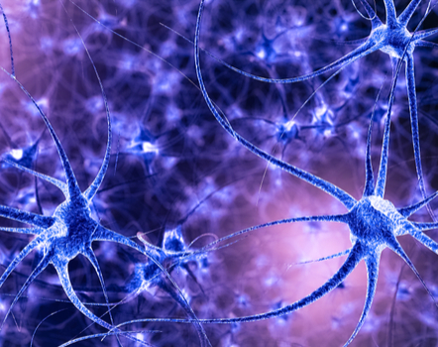
Biophysics of nervous System Electrophysiology of Neurons Synapses. Integration. EEG
Serikbolova Al’bina

Slide 2
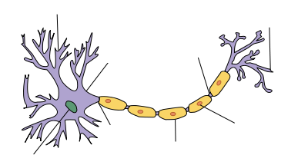
What is the Neuron?
Neuron- primary structural and functional unit of nervous system. Neurons, also known as nerve cells, send and receive signals from your brain.
4 – 130 μm
dendrite
axon terminal
node of Ranvier
soma
Schwann cell
axon hillock
initial segment
myelin sheath
nucleus

Slide 3
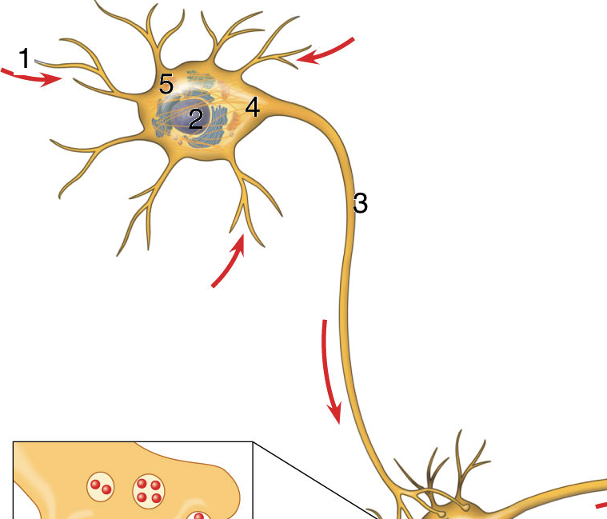
Identify the Numbered Structures
Notes:
Lets begin by reviewing the components: 1 = dendrites 2 = nucleus 3= axon 4= axon hillock 5 = cell body
Explain that today’s lesson will talk about events that occur INSIDE the neuron’s membrane and OUTSIDE the neuron’s membrane. (Show them on the diagram where these areas are located.)

Slide 4
Neurons
  cell body
  dendrites (input structure)
    receive inputs from other neurons
    perform spatio-temporal integration of inputs
    send them to the cell body
  axon (output structure)
    a fiber that carries messages (spikes) from the cell to dendrites of other neurons. When neurons receive or send messages, they transmit electrical impulses along their axons. Many axons are covered with a layered myelin sheath, which accelerates the transmission of electrical signals along the axon.

Slide 5
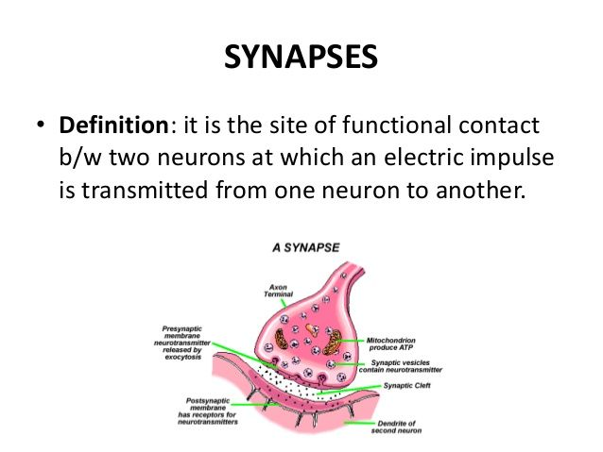

Slide 6
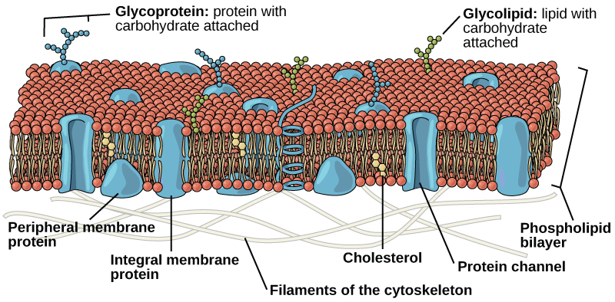
Cell membrane - reminder
double-layer of phospholipide + cholesterol + proteins

Slide 7
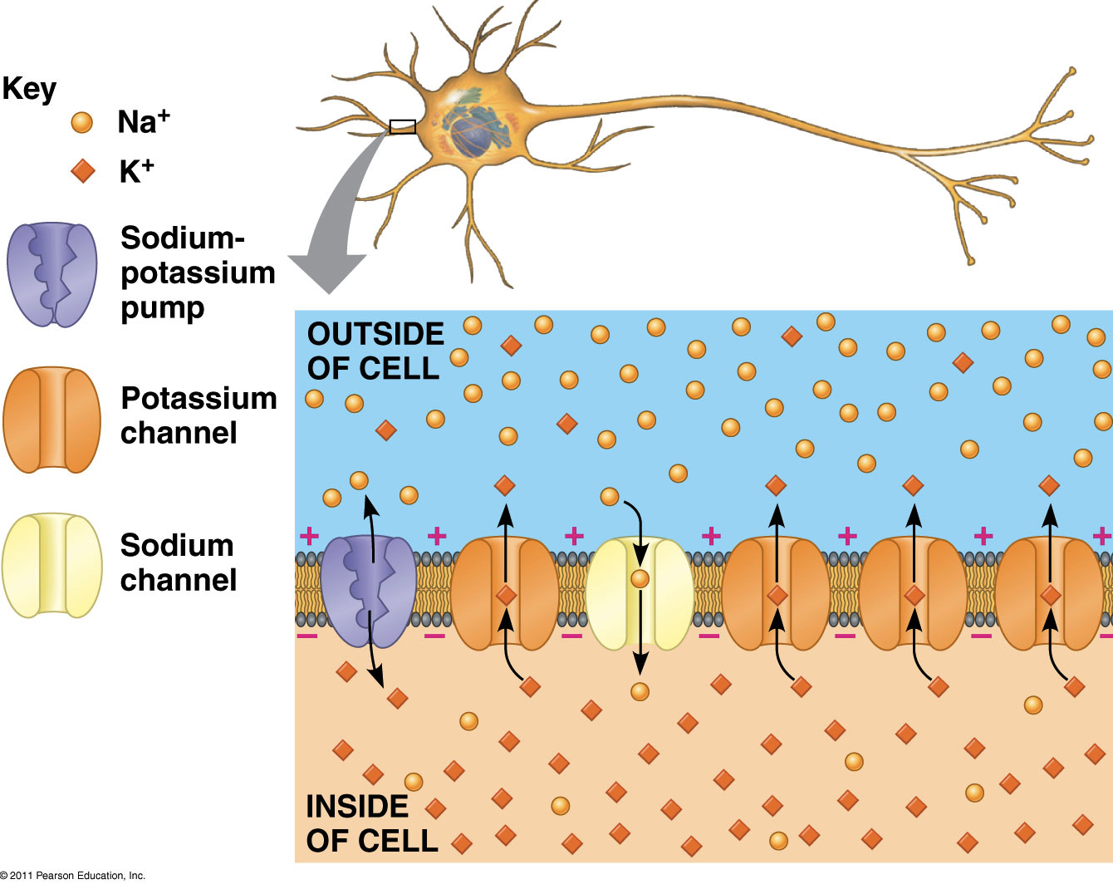
Describe a Resting Potential:
What is the charge inside the neuron at rest?
Why is the cell negative inside and positive outside? (be specific)
Notes:
Have students write out a description of a resting potential on a note card or piece of paper. They will likely want you to show the video a couple of times. When they have their description, ask them to trade with someone. Play the video one last time asking the card holders to correct any misinformation that is written. Return the card to the owner.
Resting potential = -70 mV Negatively charged proteins inside the cell are too large to move through resulting in an overall negative charge. Potassium moves out through the channels resulting in more positive external environment. Na/K pumps move sodium out and potassium out.

Slide 8
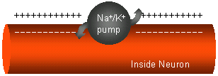
Neurones
The resting potential of the neurone Is the difference in electrical charge on the outside and inside of the plasma membrane in a resting neuron (not conducting a nerve impulse).
Neurones like other cells are more negatively charged inside than outside.
This results in a membrane potential of about – 70 milliVolts. The resting potential exists because ions are concentrated on different sides of the membrane.
  Na⁺ and Cl⁻ outside the cell.
  K⁺ and organic anions inside the cell.

Slide 9
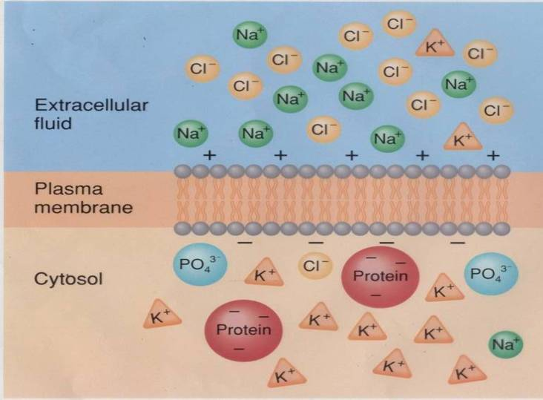
Why is there a difference?
There is 30 times more K+ inside the cell than outside and about 15 times more Na+ outside than inside.
There are also large negatively charged proteins trapped inside the cell. (This is why it is negative inside.)

Slide 10
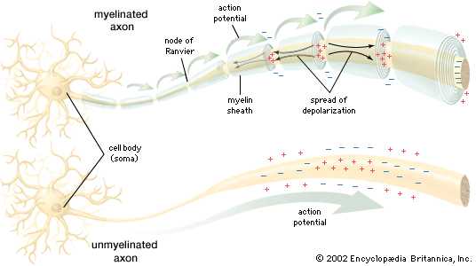
The Nerve Impulse or Action Potential
Is the electrical current moving from the dendrites to cell body to axon.
It results from the movement of ions (charged particles) into and out a neuron through the plasma membrane.

Slide 11
How is a nerve impulse generated?

Slide 12
Steps in an action potential
If a neuron receives a large number of inputs from other neurons, these signals add up until they exceed a critical level called threshold (about -55mV).
Once this threshold is exceeded, the neuron is triggered to send an impulse along its axon — this is called an action potential. At this point sodium ion channels will open.

Slide 13
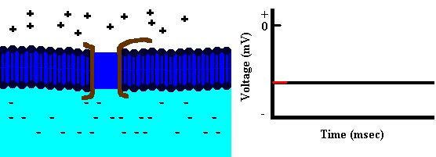
Depolarization

Slide 14
Sodium ions rush into the neuron because of diffusion forces (high to low) and charge attraction (+ and -).
The charge inside the cell eventually reaches about +30mV. (Relative to the outside of the cell the inside is now positive and the outside is negative.) At this point the sodium ion channels close.
This change in polarization (- inside to +) is called depolarization (step 4 and 5)

Slide 15
Repolarization
Next, potassium ion channels open up. This causes K+ to rush out of the cell.
As the K+ leaves it causes the inside of the cell to become negative again (-70mV). This is referred to as repolarization (step 6 and 7).

Slide 16
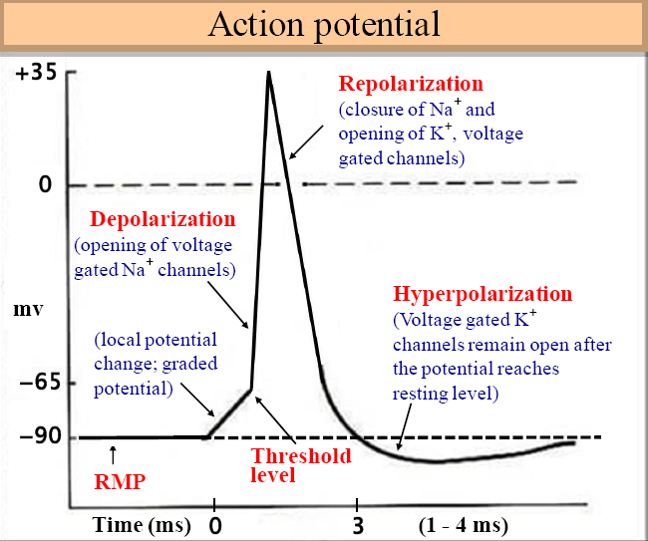

Slide 17
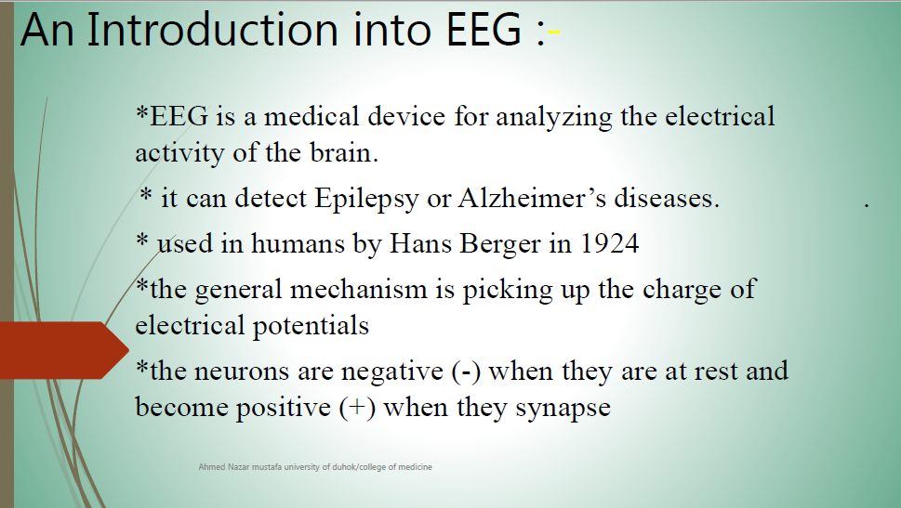

Slide 18
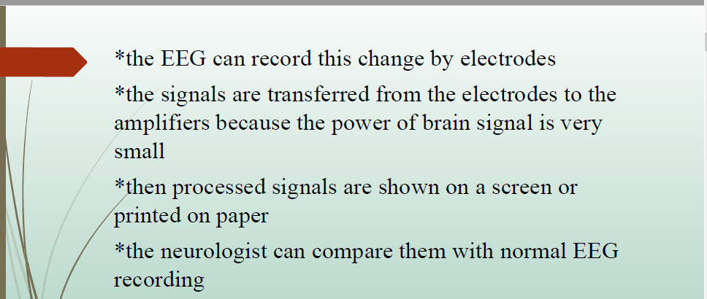

Slide 19
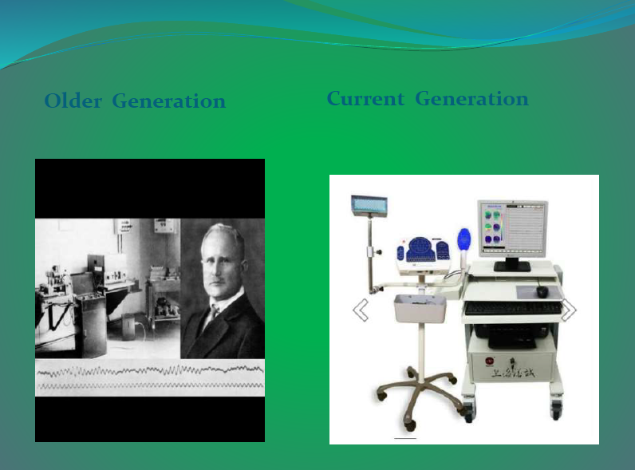

Slide 20
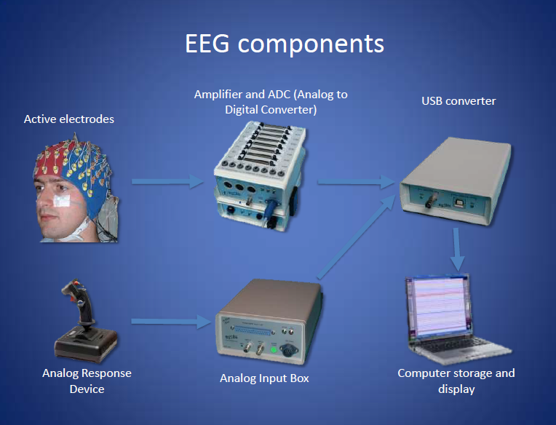

Slide 21
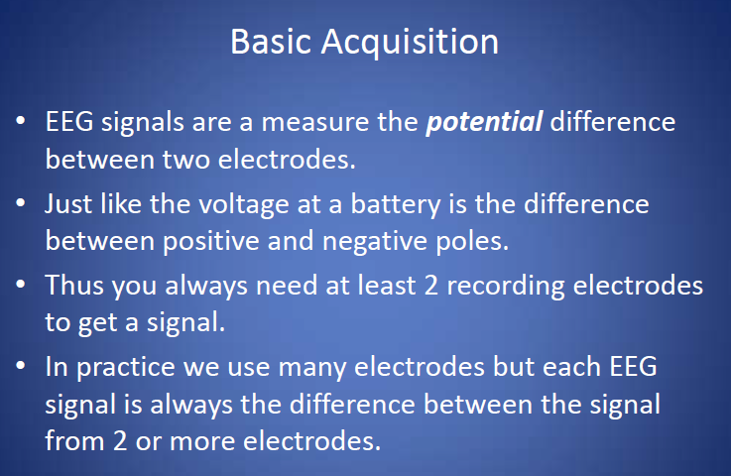

Slide 22
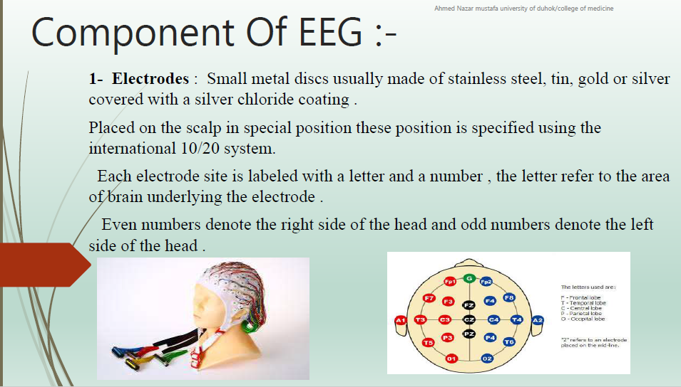

Slide 23
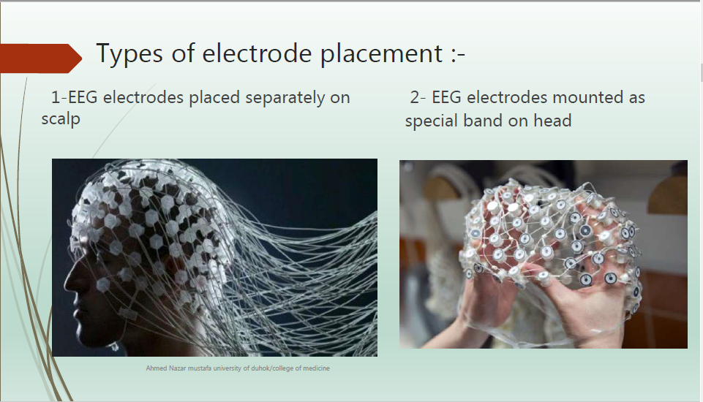

Slide 24
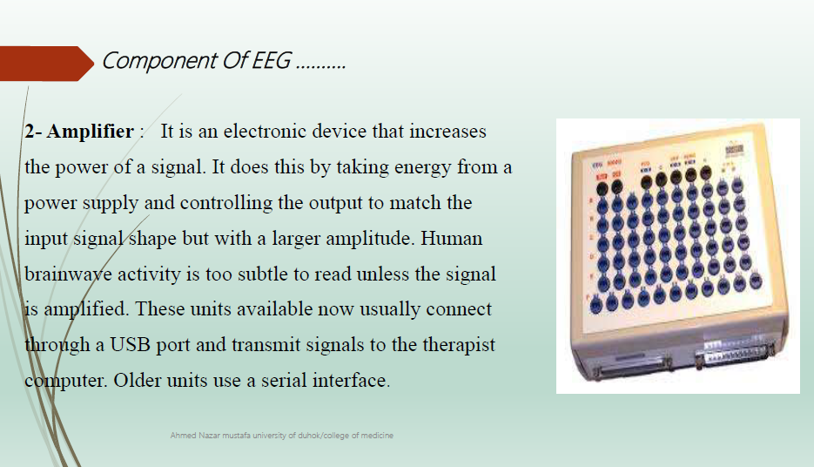

Slide 25
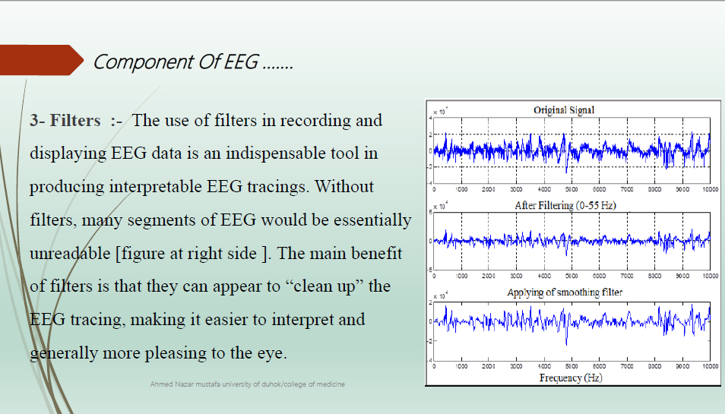

Slide 26
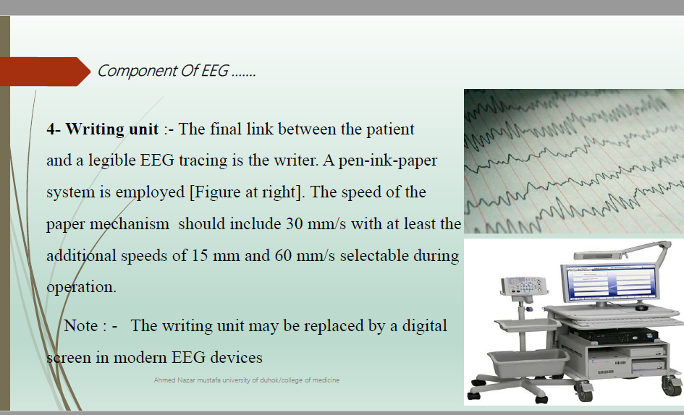

Slide 27
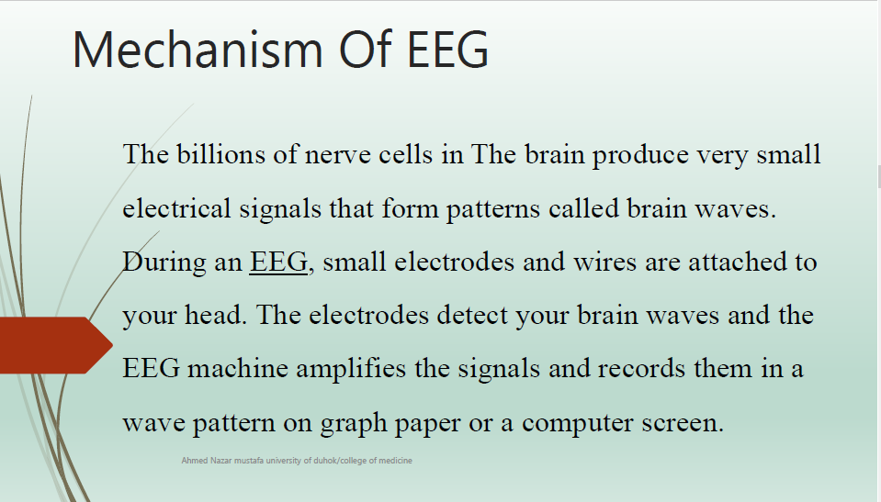

Slide 28
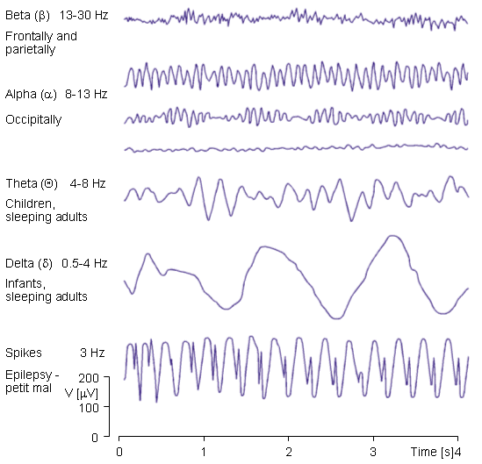
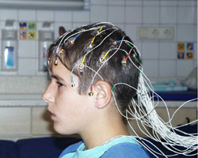
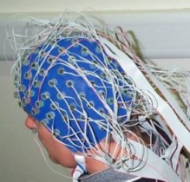
Electroencephalography (EEG)
Measures the brain’s electric
activity from the scalp
Measured signal results from
the activity of billions of neurons

Slide 29
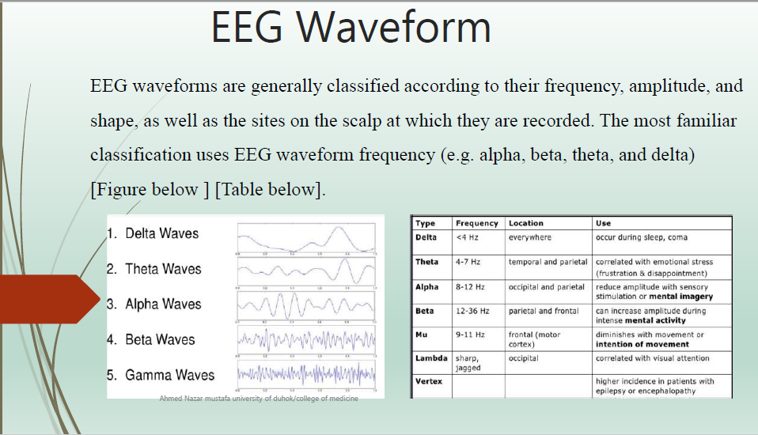

Slide 30
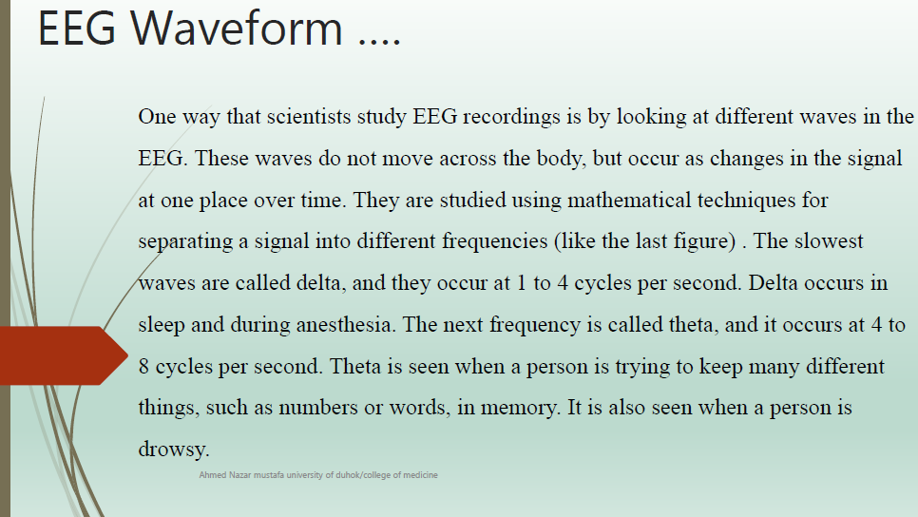

Slide 31
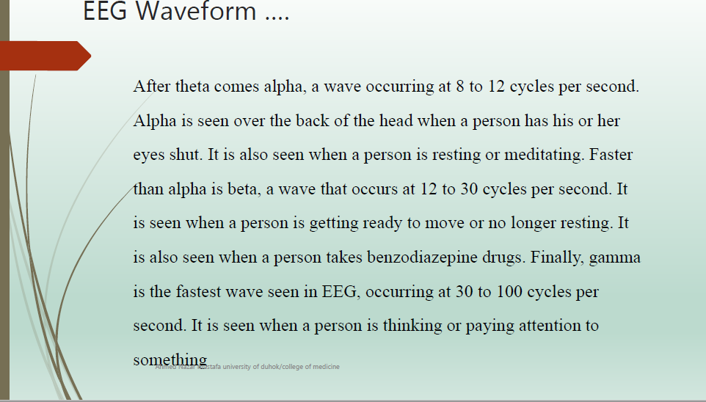

Slide 32
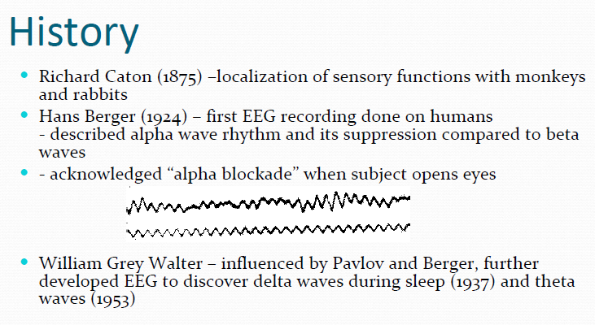
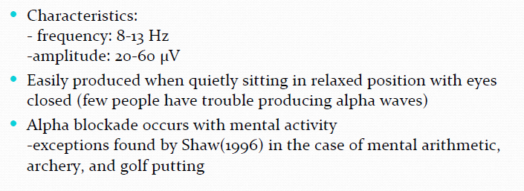

Slide 33
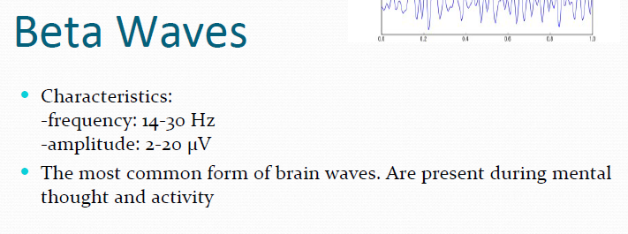
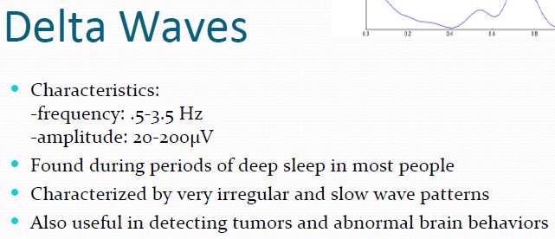
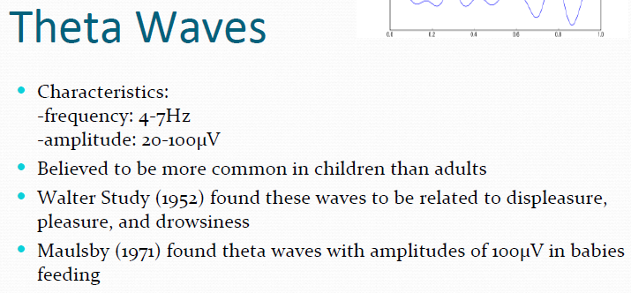
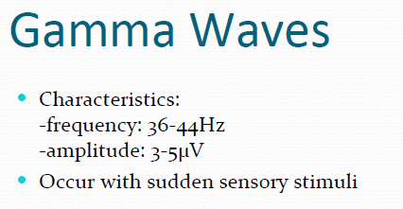

Slide 34
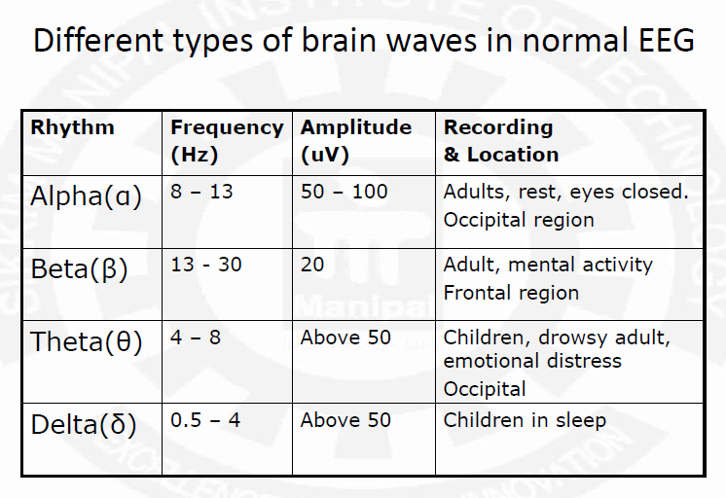

Slide 35
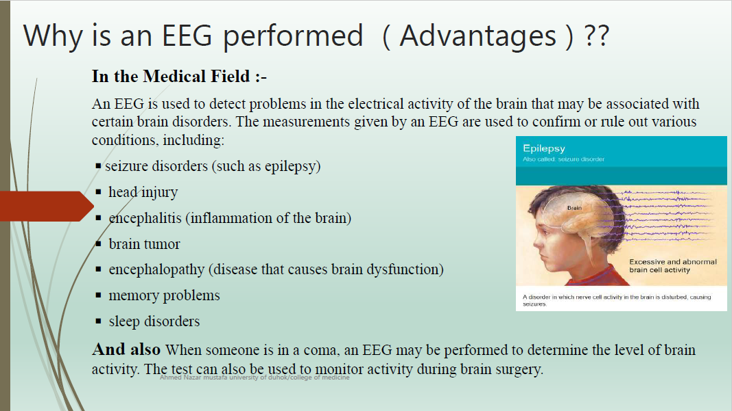

Slide 36
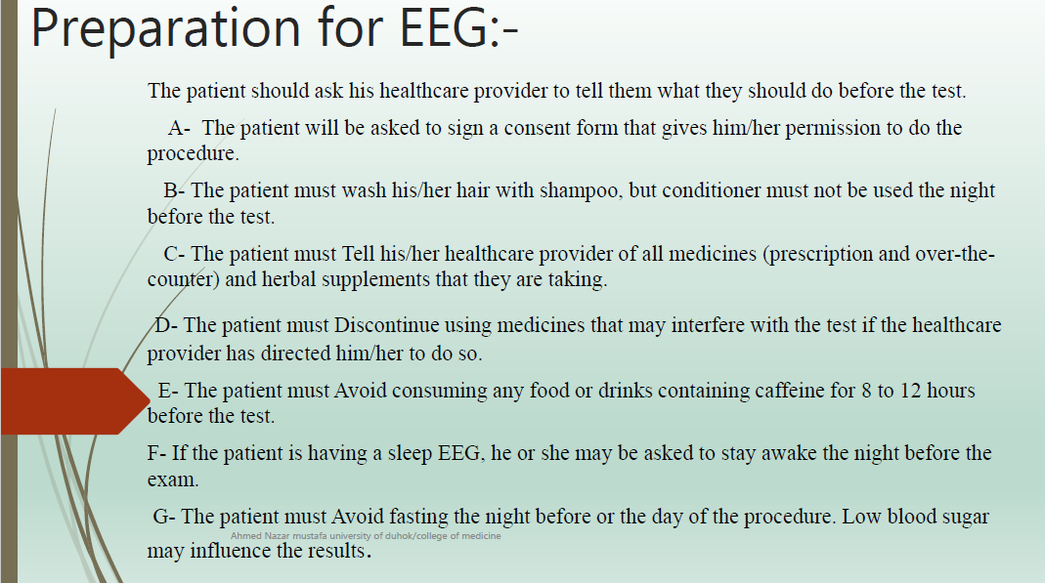

Slide 37
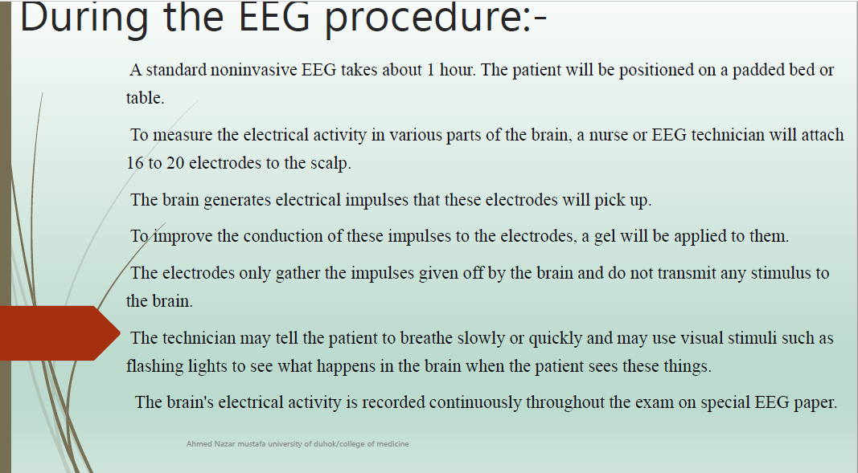

Slide 38


Slide 39
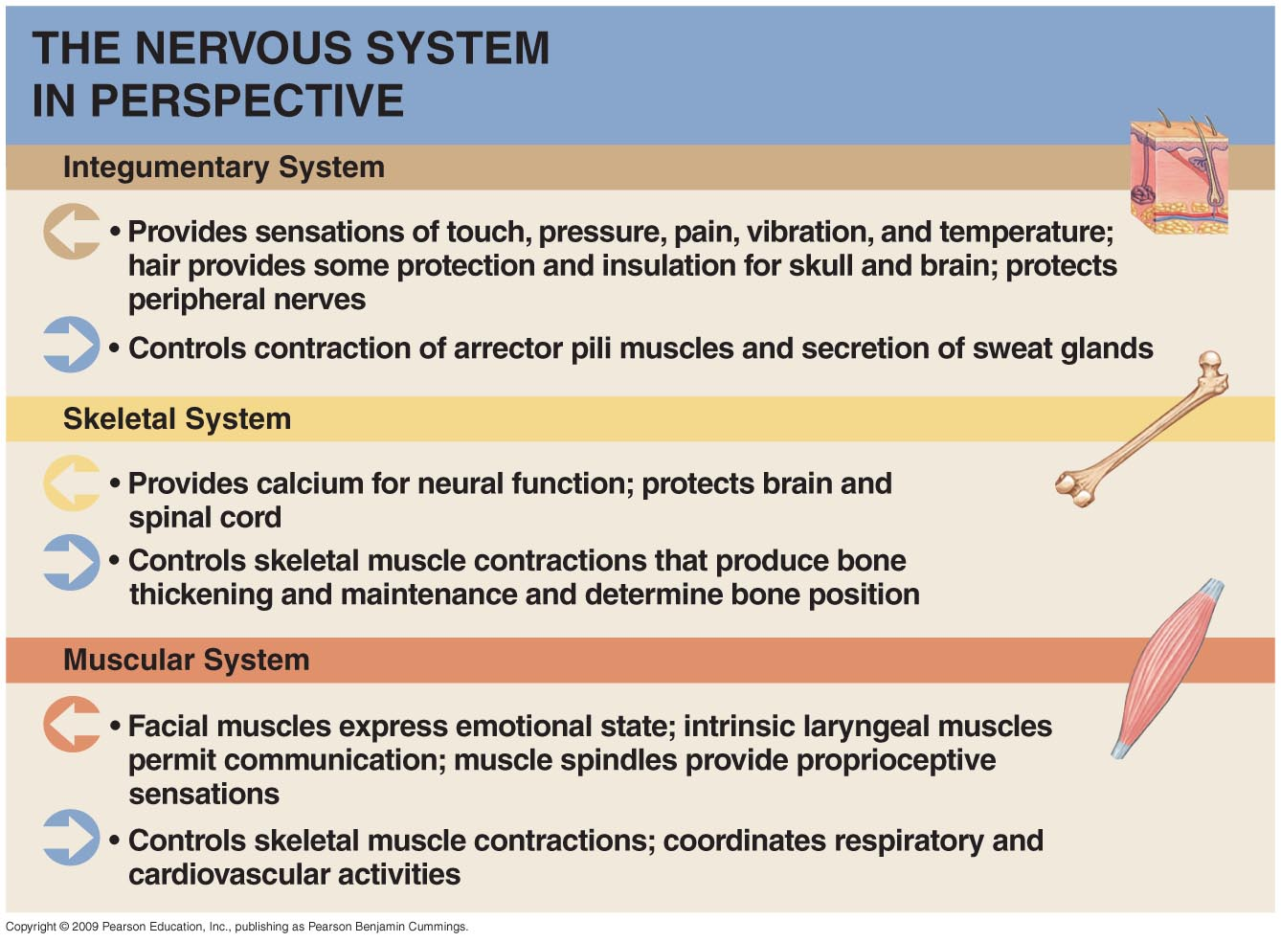
Nervous System Integration
Figure: Functional Relationships between the Nervous System and Other Systems.

Slide 40
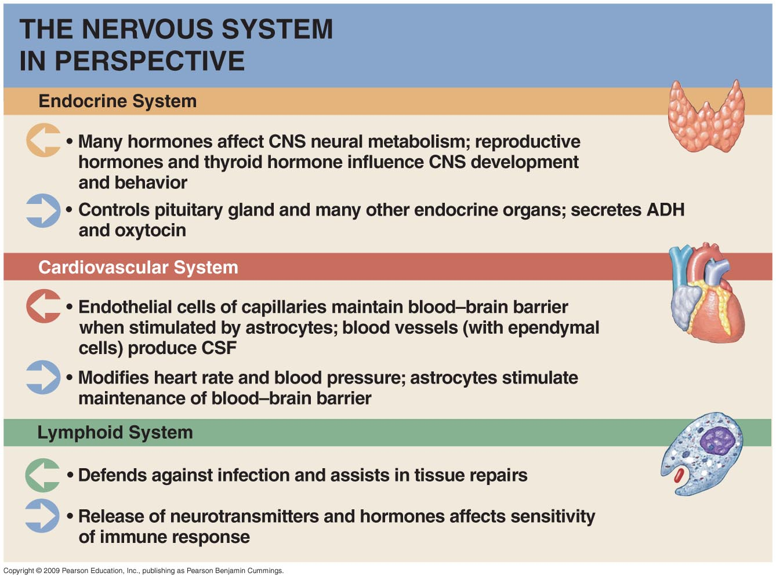
Nervous System Integration
Figure : Functional Relationships between the Nervous System and Other Systems.

Slide 41
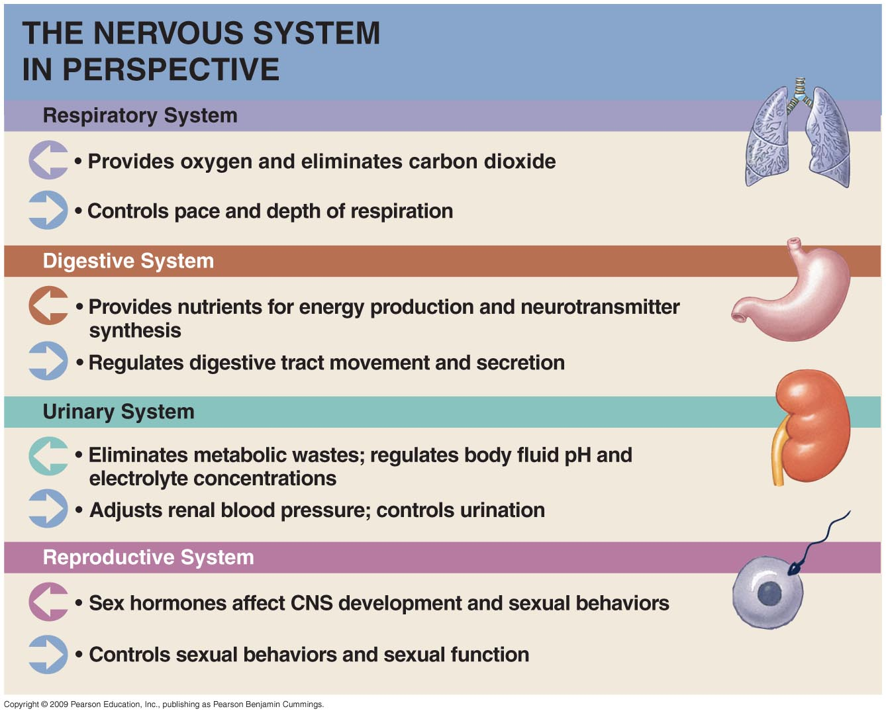
Nervous System Integration
Figure: Functional Relationships between the Nervous System and Other Systems.

Slide 42
Task 1. Write answers to the following questions:
What is the neuron? Structure, function.
How is a nerve impulse( action potential) generated?
What methods used for EEG registration?
Historical background of EEG.
EEG components and mechanism of EEG.
Indications for the EEG.
Routine tests for EEG.
Nervous System Integration

Slide 43
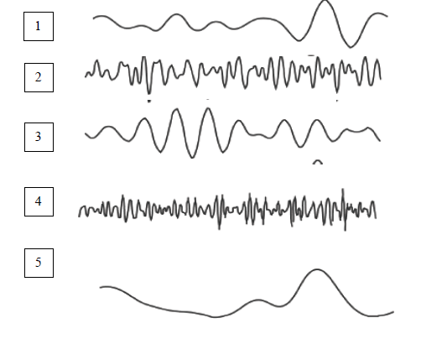
Task 2. Give detailed answers to questions
1. The diagram shows 5 waves that we can meet at carrying out EEG. Determine names (alpha, beta, theta, delta) of these waves for each cases and describe their frequency and amplitude characteristics.
2. What is the EEG rhythm registered in the deep sleep stage? Describe it.

Slide 44
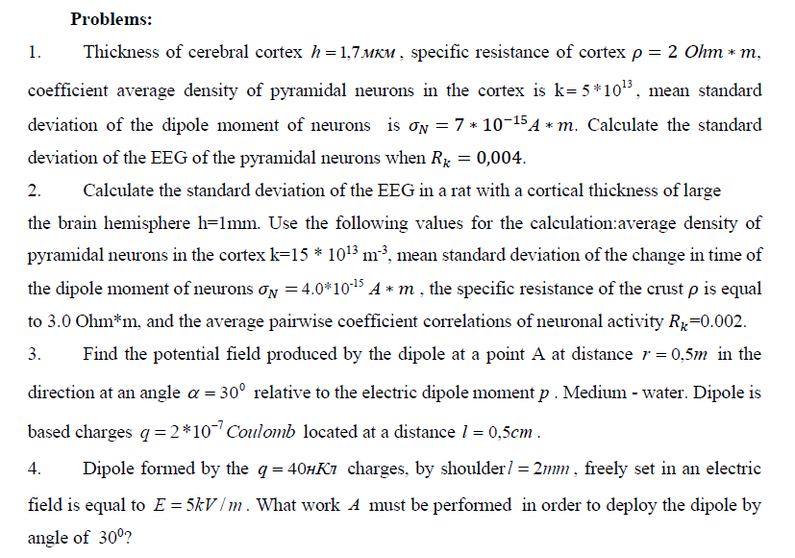
Task 3 Practical works(Next lesson)

Slide 45
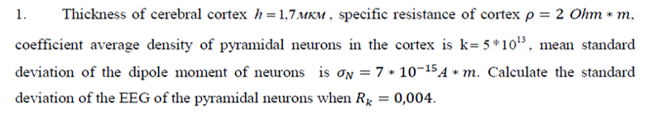
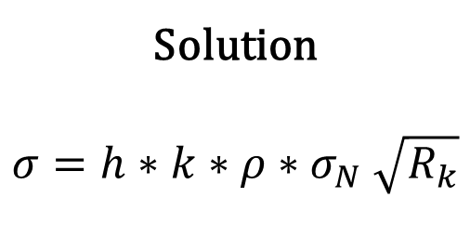
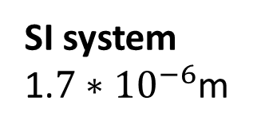
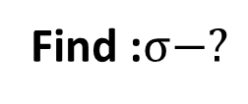
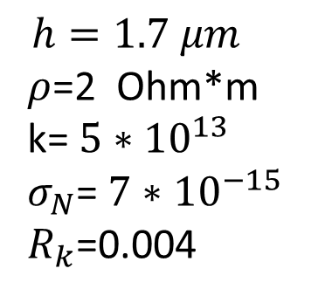
G
Given:
SI system
1.${7∗10}^{−6}$m
Solution
$$σ=h∗k∗ρ{∗σ}_{N}\sqrt{R_{k}}$$
$$h=1.7 μm$$
$ρ$=2 Ohm*m
k= ${5∗10}^{13}$
$σ_{N}$= ${7∗10}^{−15}$
$R_{k}$=0.004
Find :$σ−?$

Slide 46
Test 14 questions (Next lesson)

Slide 47

THANK YOU

